Slide 1
OSPF Security
Chapter 6

Slide 2
Learning Outcomes
Implement OSPFv2 and v3 security through various authentication and encryption methods

Slide 3
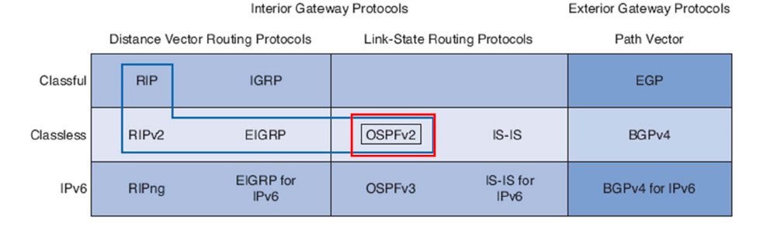
Routing Protocols
Routing Protocols are used by the routers
To communicate with each other
To determine best path to the destination
To make dynamic adjustments to its conditions
You can enable authentication in OSPF in order to exchange routing update information in a secure manner.

Slide 4
OSPF Authentication
There are 2 types of authentication done:
Null (no authentication, default) ➔ Type 0
Simple password (or plaintext) authentication ➔ Type 1
MD5 authentication ➔ Type 2
For both simple and MD5 authentication, the router which receives an OSPF LSA packet will first check to see from which source it arrived from (to authenticate the source).
The neighbour (source router) must have the same key (password) configured for a successful authentication link.

Slide 5
Simple Password Authentication
Simple authentication is used when devices within an area cannot support the more secure MD5 authentication. This authentication leaves the internetwork vulnerable to a sniffer attack, in which packets are captured by a protocol analyser and the passwords can be read. However, it is useful when you perform OSPF reconfiguration, rather than for security. For example, separate passwords can be used on older and newer OSPF routers that share a common broadcast network to prevent them from talking to each other. Plain text authentication passwords do not have to be the same throughout an area, but they must be the same between neighbours.
Source Cisco.com

Slide 6
Simple Password Authentication
R1(config-if)# ip ospf authentication
R1(config-router)# area 0 authentication
Both the above commands activate the simple authentication type of the interface and the area respectively
R1(config-if)# ip ospf authentication-key Cisco123
On the interface facing the neighbour router, a password (Cisco123) is being configured. The other side router needs to have the same password configured on it as well.

Slide 7
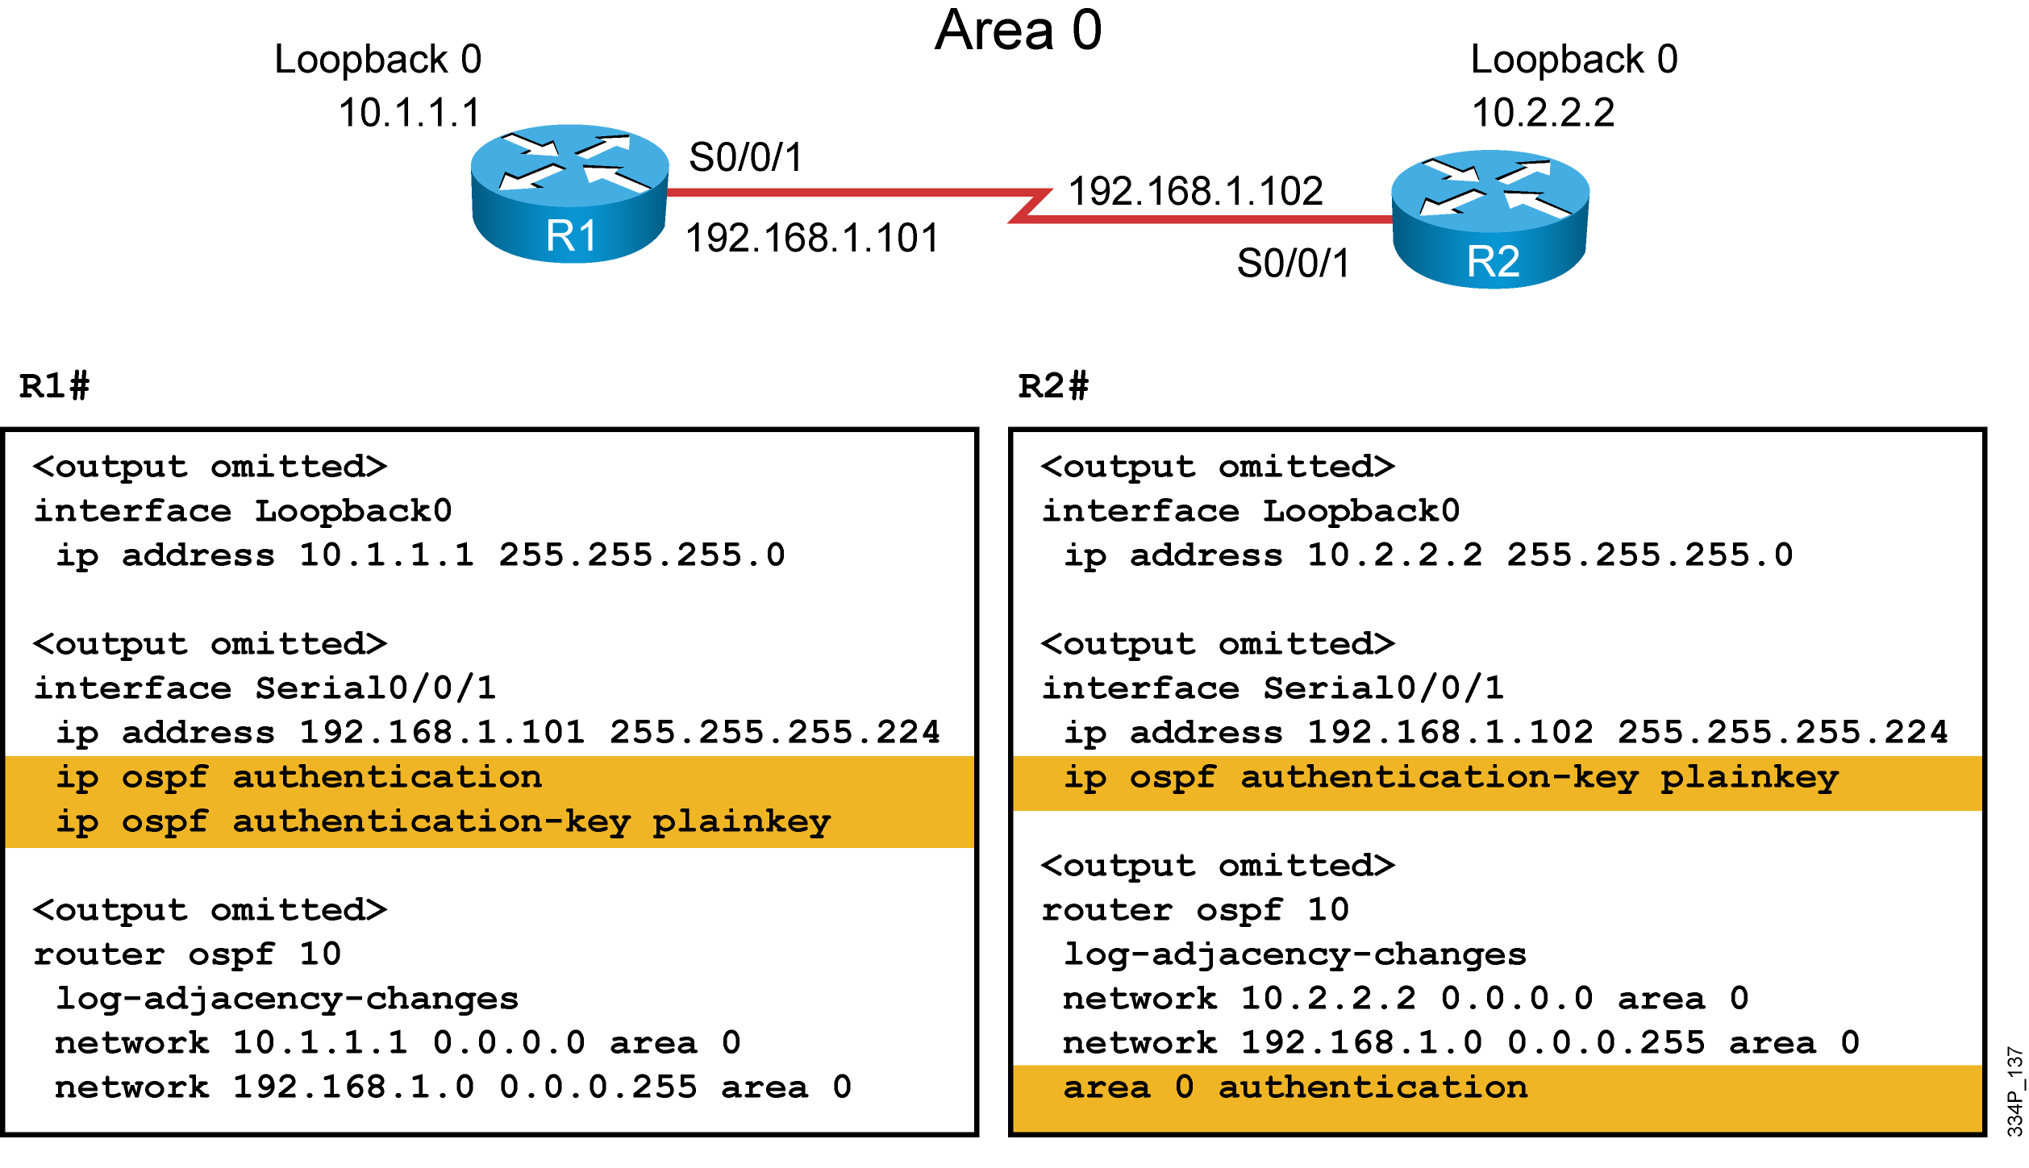
Simple Password Authentication

Slide 8
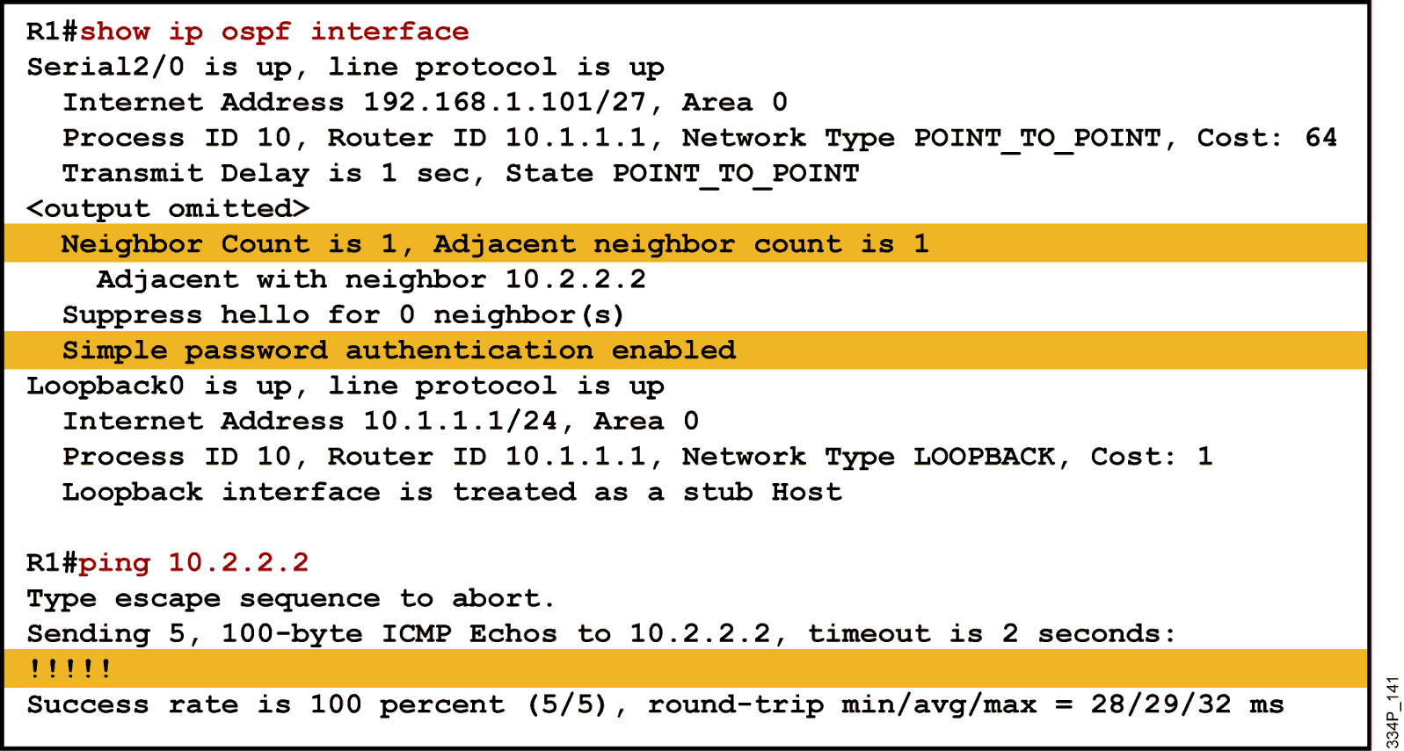
Verifying Authentication

Slide 9
MD5 Password Authentication
MD5 authentication provides higher security than plain text authentication. This method uses the MD5 algorithm to compute a hash value from the contents of the OSPF packet and a password (or key).
This hash value is transmitted in the packet, along with a key ID and a non-decreasing sequence number.
The receiver, which knows the same password, calculates its own hash value. If nothing in the message changes, the hash value of the receiver should match the hash value of the sender which is transmitted with the message.
Authentication is then deemed successful.
Source: Cisco.com

Slide 10
MD5 Password Authentication
R1(config-if)# ip ospf authentication message-digest
R1(config-rouer)# area 0 authentication message-digest
As with the simple authentication, the above 2 commands activate the MD5 authentication on the interface and area respectively
R1(config-if)# ip ospf message-digest-key 1 md5 Cisco123
This command defines a key ID of 1 and the key of Cisco123. The neighbouring router must a have the same combination of key ID and key configured in order for the authentication to be successful.

Slide 11
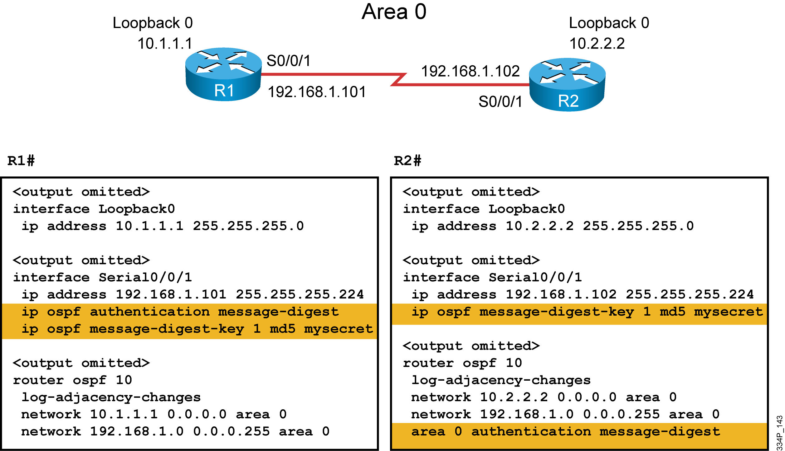
MD5 Password Authentication

Slide 12
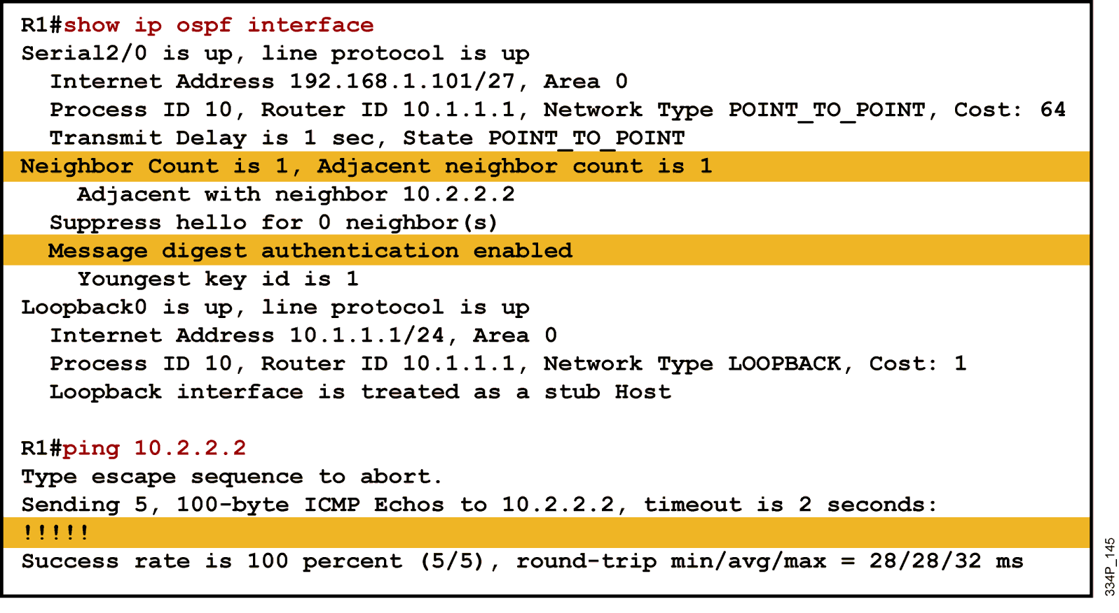
Verifying Authentication

Slide 13
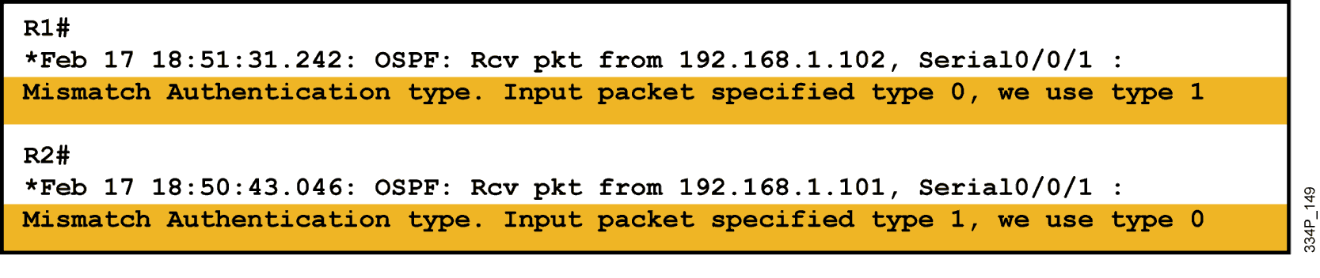
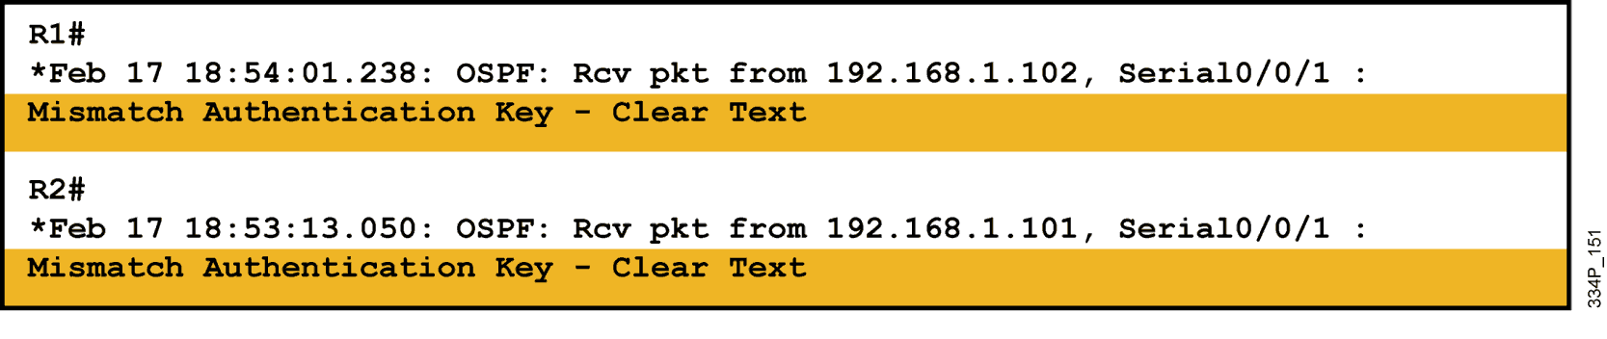
Troubleshooting Configuration
Simple authentication not configured on R2
Different Simple password Keys on R1 and R2

Slide 14
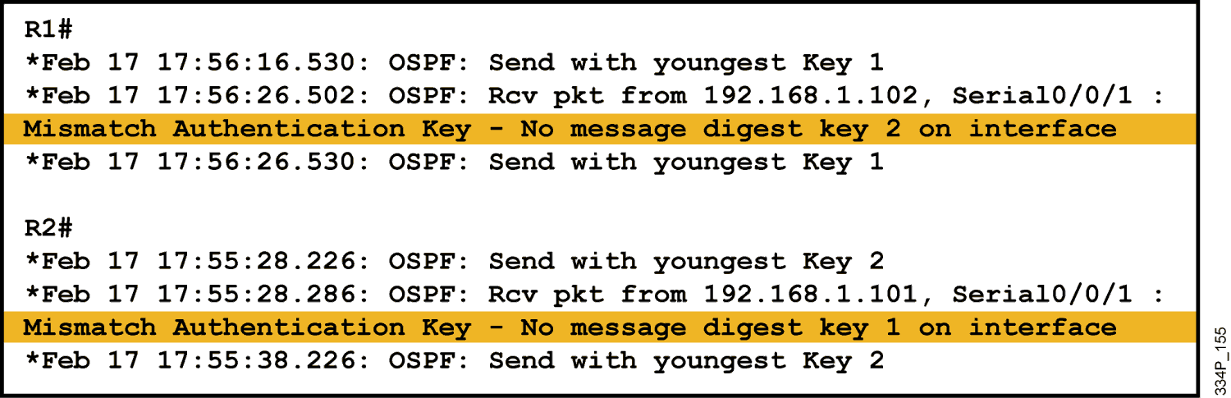
Troubleshooting Configuration
MD5 authentication configured on both routers
Router R1 has key 1 and router R2 has key 2, both with the same passwords:

Slide 15
Service Password Encryption
Both security options in OSPF strive to only authenticate the user but not to encrypt any data.
It is recommended to configure the service password-encryption command on all routers to encrypt the passwords on any configuration file displays.
This guards against the password being learnt by observing the text copy of the config file.
R1(config)# service password-encryption

Slide 16
THE END

